Slide 1
WEST BEACH ROAD ASSOCIATION WATER SYSTEM ANNUAL REPORT 2018
JIM PATTON, CHAIRMAN
FOR
WATER SYSTEM OPERATIONS

Slide 2
WEST BEACH ROAD ASSOCIATION WATER SYSTEM
CURRENT STATUS
OF
WATER SYSTEM OPERATIONS AND FINANCES
COMPLIANCE WITH WAC RULE ON
WATER USE EFFICIENCY
3. WATER SYSTEM INFRASTRUCTURE AND RECAPITALIZATION PLANS

Slide 3
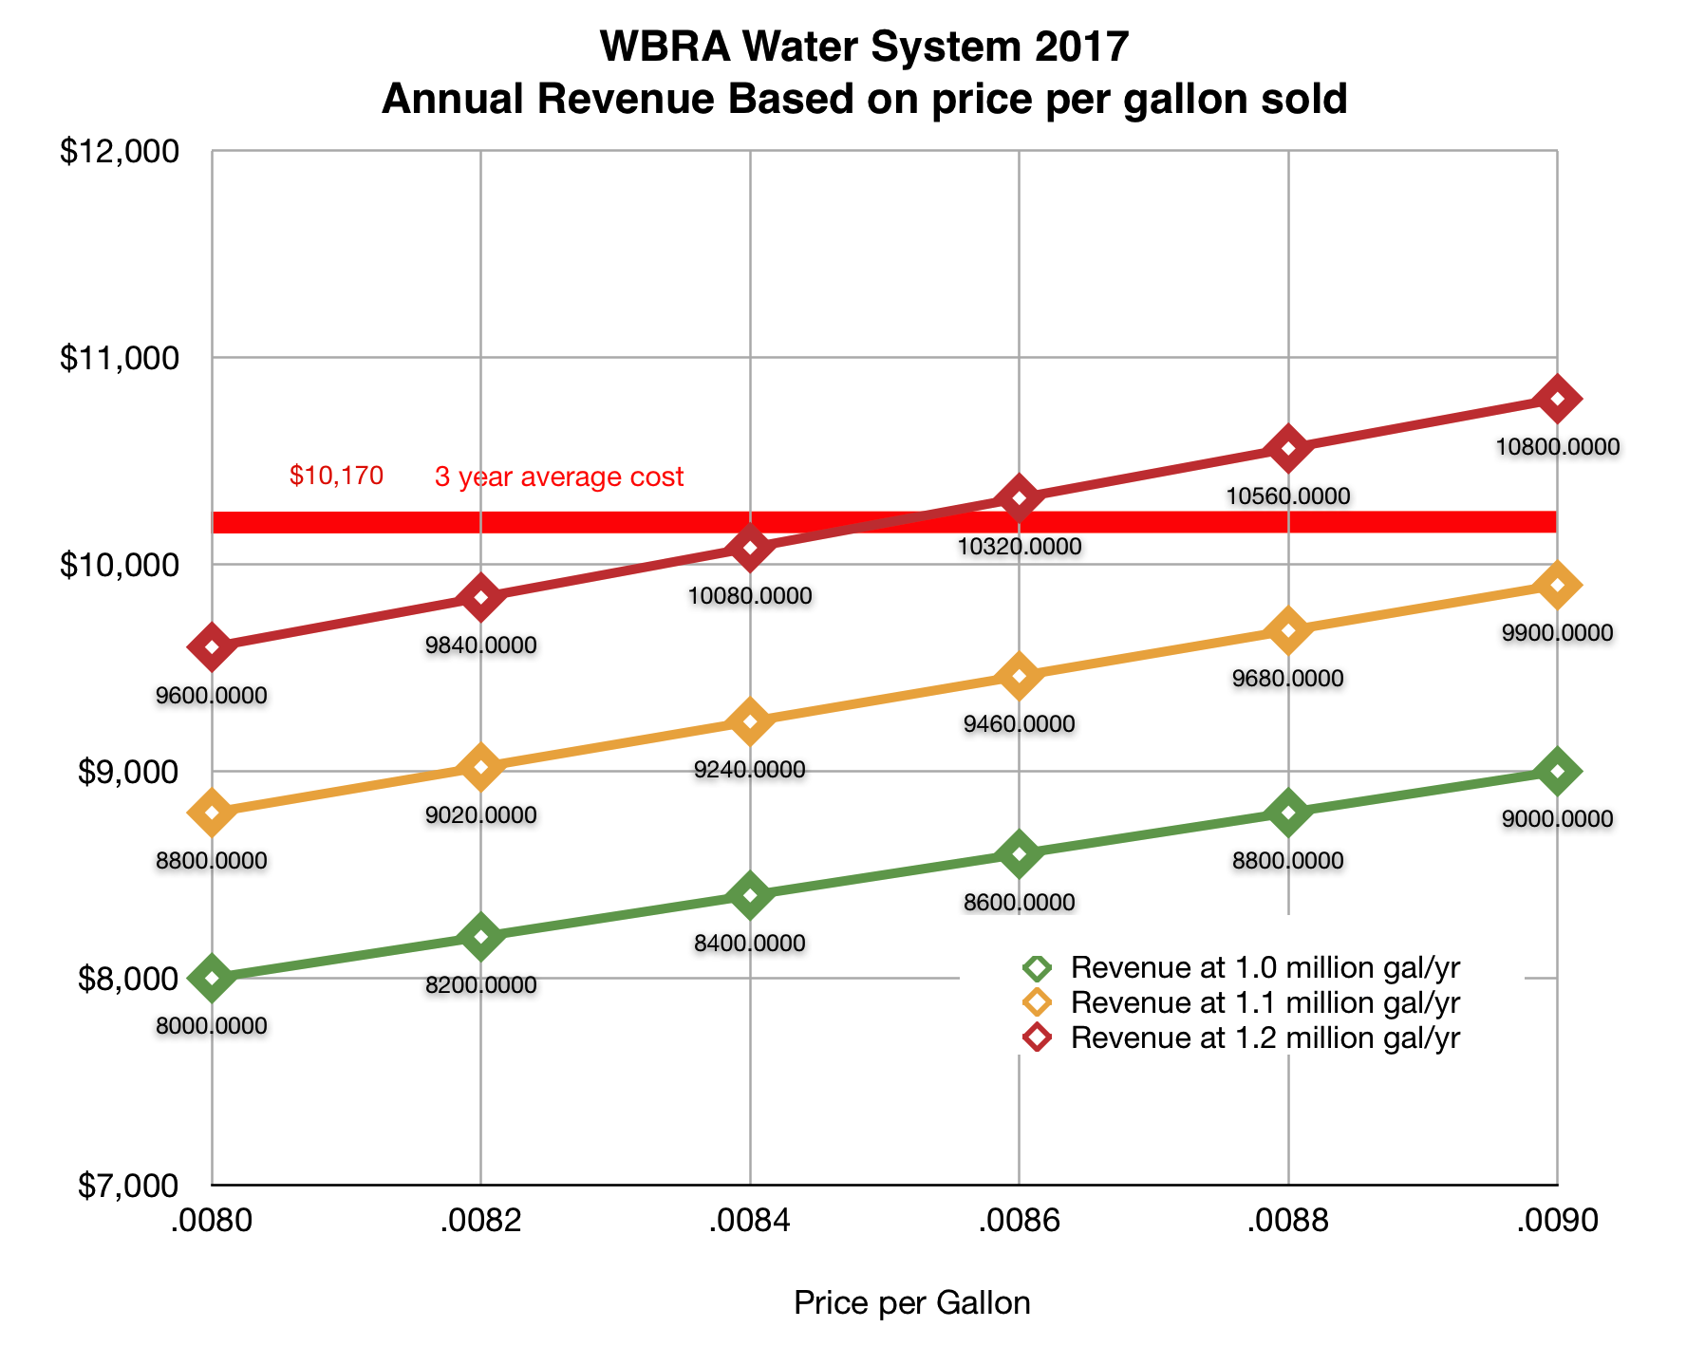

Slide 4
WEST BEACH ROAD ASSOCIATION WATER SYSTEM
WASHINGTON ADMINISTRATIVE CODE (246-290-800) MANDATES:
Water systems serving less than 1,000 connections develop water use efficiency performance by July 1, 2009
Goals shall be set in a public forum (E.G., A hoa ANNUAL MEETING) AT LEAST EVERY 6 YEARS
We set our goal of average daily use per home of 163 gallons and a distribution system “leakage” of 7% in September 2008!
Last year, our average daily use per home was 202 gallons and our 3-year annual average “leakage” was 8.8%
We discovered and fixed two leaks in the last three years – but, we must reconsider our goal of 163 gallons avg. daily use per home!

Slide 5
WEST BEACH ROAD ASSOCIATION WATER SYSTEM
RECOMMENDATIONS
We are meeting our operating costs so DO NOT CHANGE THE FEE PER GALLON IN 2019
ESTABLISH NEW WATER USE EFFICIENCY GOAL and report to the state [King makes “water use efficiency annual performance reports” to the state for each of its customers]
IF GOAL IS NOT achieved IN 2019 CONSIDER “graduated” fee system for 2020

Slide 6
WEST BEACH ROAD ASSOCIATION WATER SYSTEM
WATER SYSTEM INFRASTRUCTURE AND RECAPITALIZATION PLANS
SYSTEM COMPONENTS, CONDITIONS, EXPECTED REPLACEMENT
NEAR-TERM RECAPITALIZATION PLANS
RECOMMENDED ASSESSMENT FOR RECAPITALIZATION

Slide 7
WEST BEACH ROAD ASSOCIATION WATER SYSTEM
SYSTEM COMPONENTS & CONDITIONS
COMPONENT CONDITION EXPECTED REPLACEMENT YEAR
RESERVOIR TANK GOOD 2025 - 2035
DISTRIBUTION PIPES UNKNOWN (NO LEAKS) 2035
WELL PUMP NEW (2016) 2046
HYDRANTS GOOD 2025 - 2035
RESIDENTIAL METERS GOOD 2020 - 2030
DISTRIBUTION PUMPS GOOD* *2020 (1 hp PUMP)
PUMP HOUSE STRUCTURE NEW ROOF (2015) / WALLS * *2018 (RESURFACE EXT. WALLS)
TREATMENT (FILTERS & CONTACT TANK) NEW (2015) 2030

Slide 8
WEST BEACH ROAD ASSOCIATION WATER SYSTEM
NEAR-TERM RECAPITALIZATION PLANS
Project cost est. year
DEDICATED WATER SAMPLE TAP(S) $1,500 2019
ALUMINUM COVER FOR WELLHEAD $1,500 2019
EXTERNAL WALLS OF PUMPHOUSE (BASE) $200 2018
REPLACE 1 HP DIST. PUMP (possible) $3,000 2020
INSTALL ISOLATION VALVE (EMERGENCIES) $1,000 2019

Slide 9
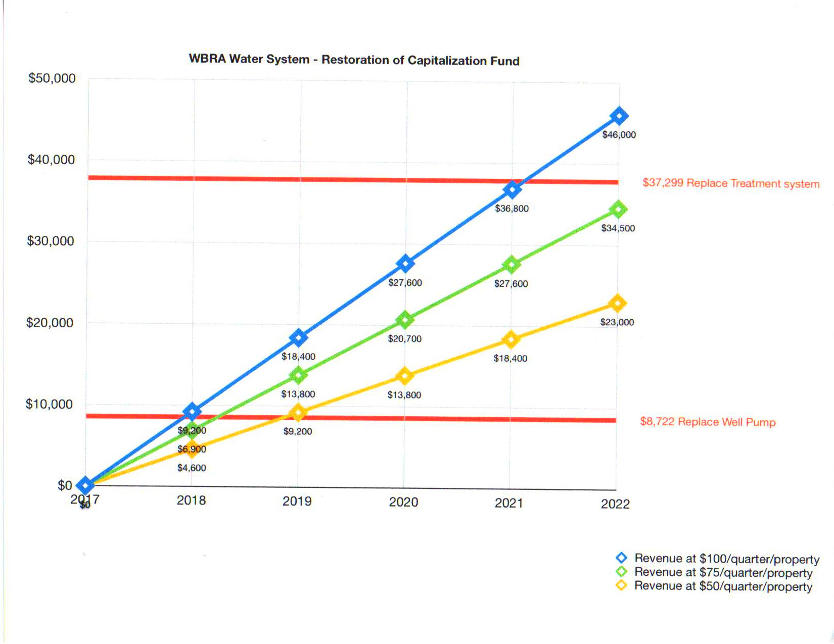

Slide 10
WEST BEACH ROAD ASSOCIATION WATER SYSTEM
RECOMMENDED ASSESSMENT FOR RECAPITALIZATION
Remain at $300 per year per member through 2019 (accrue $6,900)
Reassess need in December 2019 & adjust if appropriate

